Slide 1


Moosic
SHUFFLE SOCIETY
Hetty Nour Ali

Slide 2

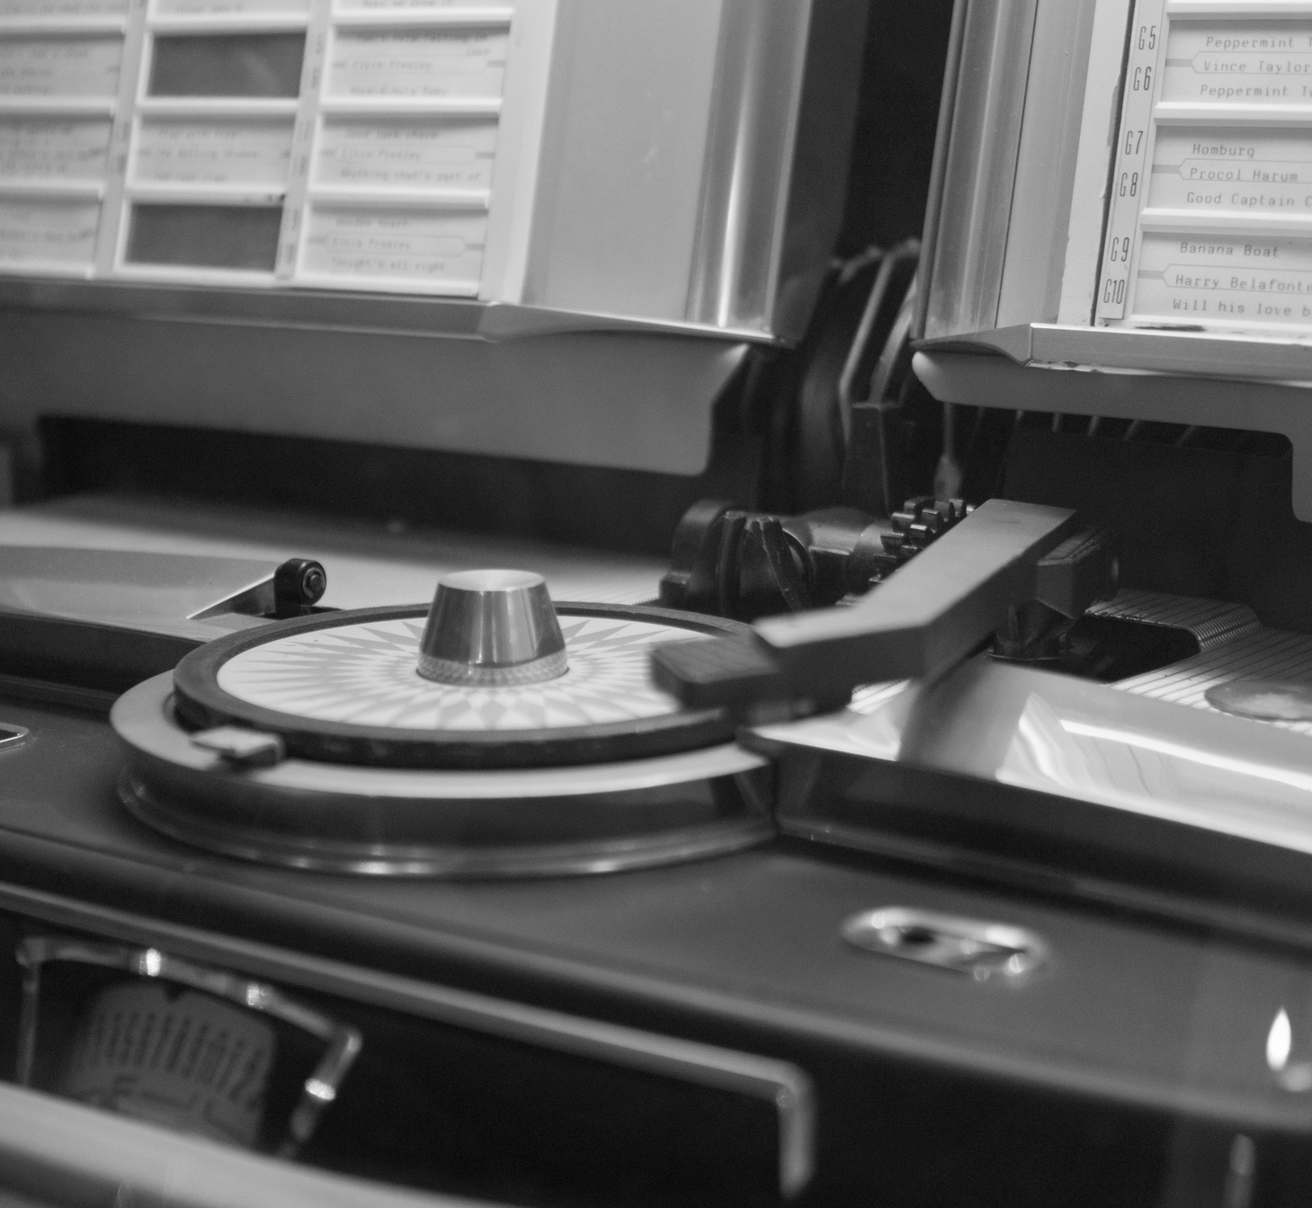
Moosic
HOW WE CREATED THE PROTOTYPE
Prepared Moosic’s dataset
Scaled features with: MinMaxSclaer & PowerTransformer, StandardSclaer.
Evaluated clustering quality using Elbow Method, silhouette score, PCA, and K-distance.
Clustering algorithms: K-Means, DBSCAN, HDBSCAN, Agglomerative.
Generated playlists based on final clusters.
Page | 02

Slide 3

Moosic
THE AUDIO FEATURES WE USED
Strong features: Danceability, Energy, Tempo, Acousticness, Key, Valence.
These describe rhythm, emotion, and musical mood helping to create natural playlists.
Confusing features: Time Signature, Mode, Loudness, Liveness, Duration, Speechiness.
we focused on “Strong features” that gave the clearest sound similarity.
Page | 03

Slide 4

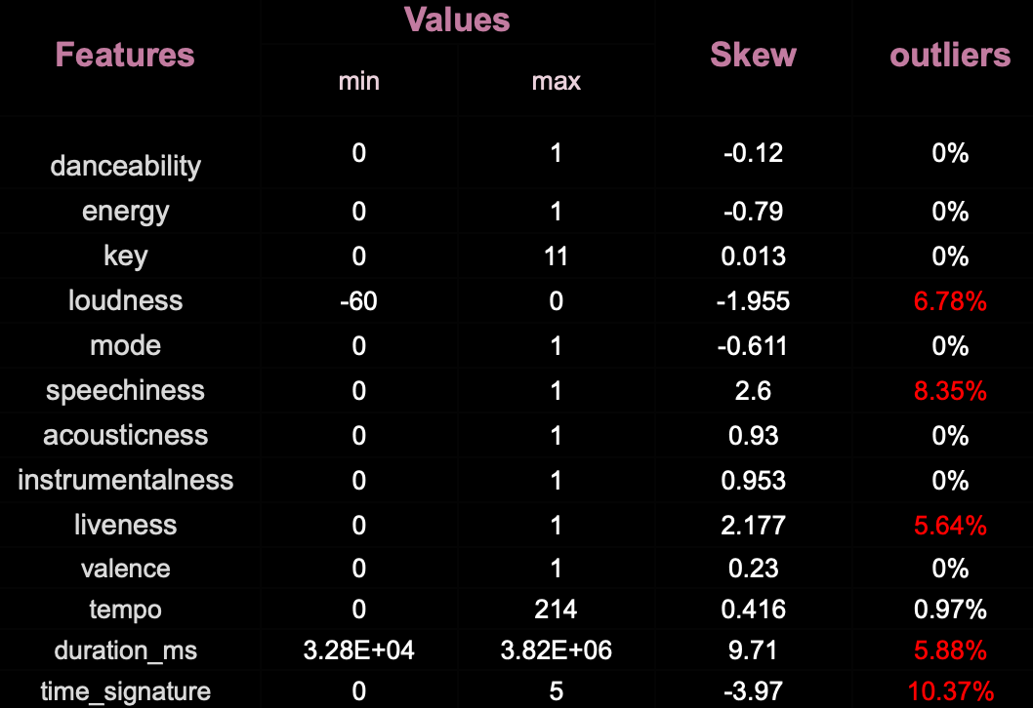
Moosic
FEATURE ANALYSIS & OUTLIER DETECTION
Page | 04

Slide 5
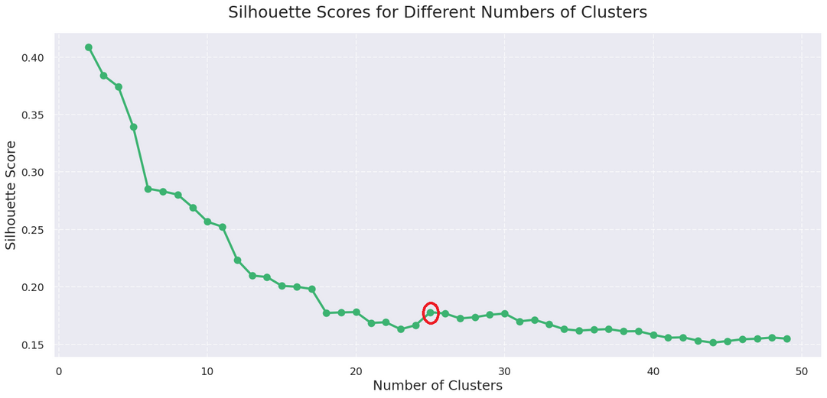
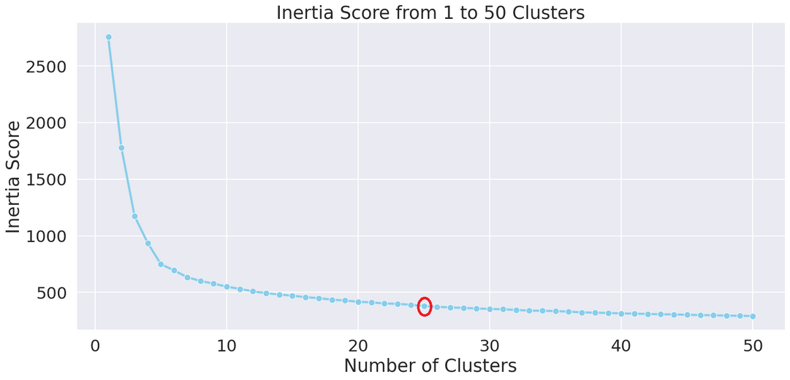
Moosic
THE NUMBER OF PLAYLISTS (CLUSTERS)
K-Means | 25
DBSCAN | 6
Gaussian mixture | 9
HDBSCAN | 48
Agglomerative | 48
Page | 05

Slide 6
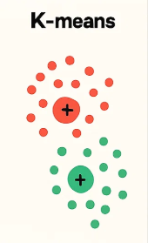
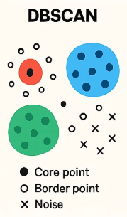
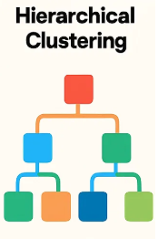
Moosic
CLUSTERING MODELS WE USED
Page | 06

Slide 7
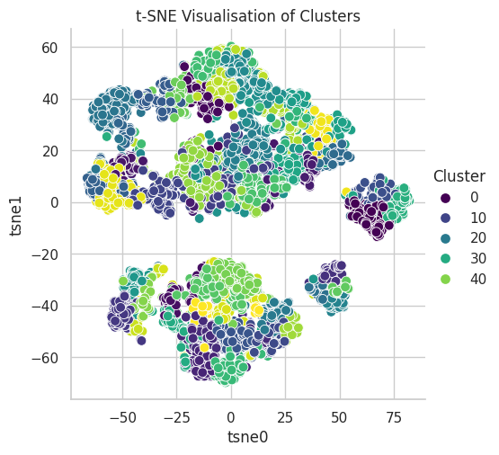
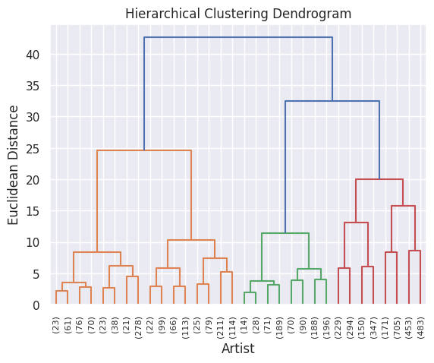
Moosic
Page | 07

Slide 8
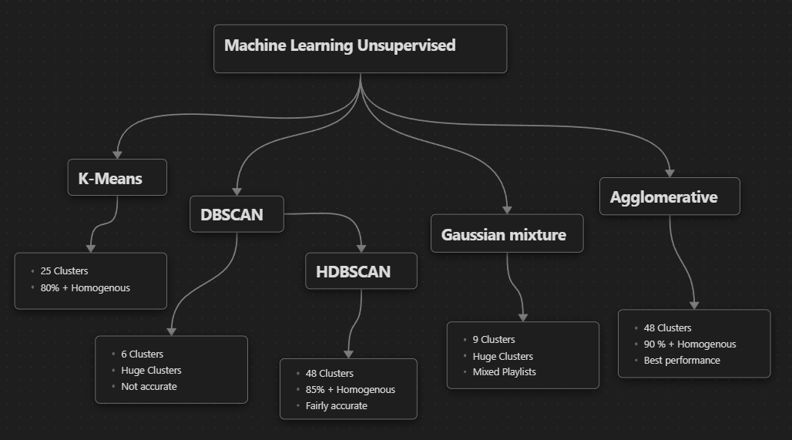
Moosic
EFFECTIVENESS OF CLUSTERING MODELS
Page | 08

Slide 9


Moosic
OTHER DATA THAT COULD IMPROVE PLAYLIST CREATION
User related Data (listening habits, skip rate, time of day, etc.)
Lyrics sentiment & language
Relese year, popularity
Group artist’s songs together
Popular songs in social or regional circles
People listened to this song also listened to another song
The mood or context (workout, study, Party, relax, etc.)
Page | 09

Slide 10

Moosic
NEXT STEPS
Expand data sources: Include user behavior, context, and social trends.
Optimize clustering: Fine-tune current algorithms and explore hybrid models.
Leverage feedback loops: Integrate user interactions to enhance playlist relevance.
Page | 10

Slide 11
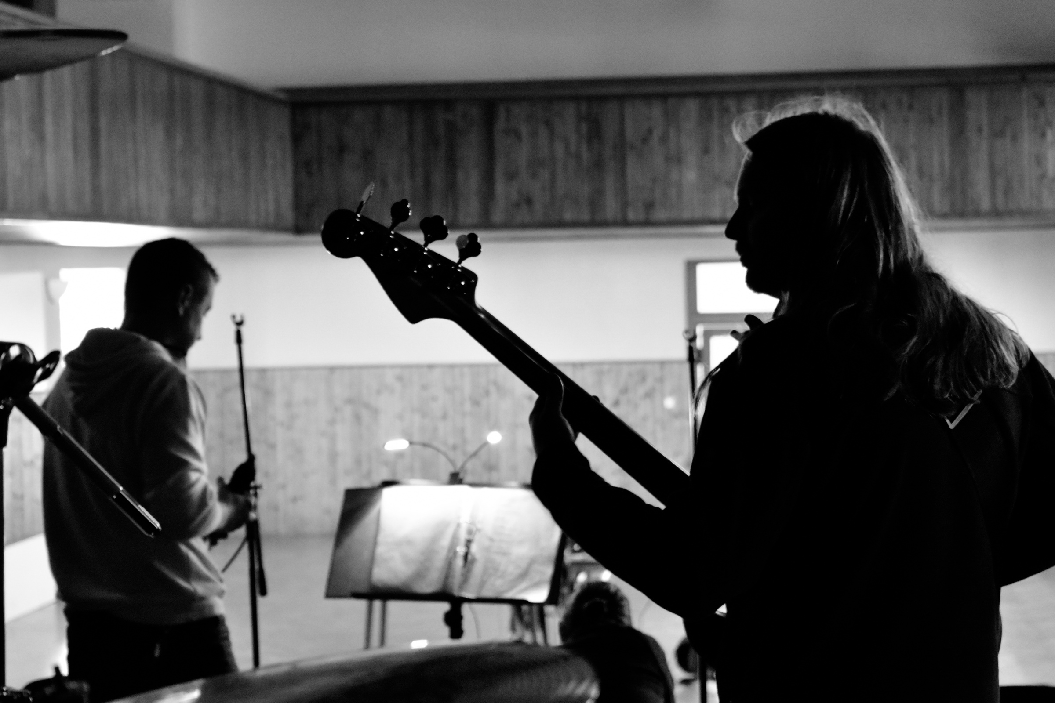
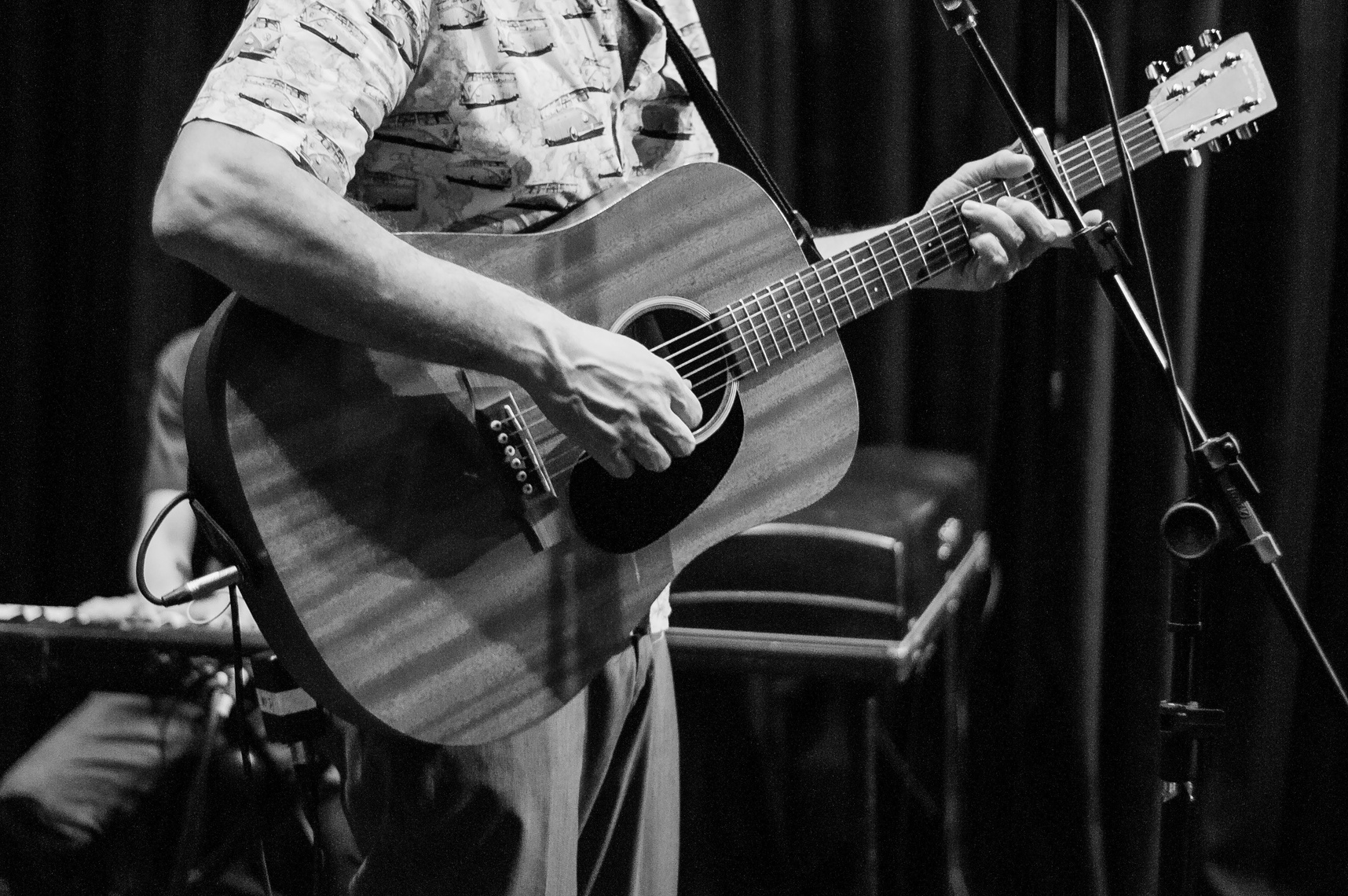
Moosic
THANK YOU
Hetty Nour Ali

